Slide 1
Natural Language Processing (NLP)
Lecture 19: Sentiment Analysis
Dr. Muhammad Taimoor Khan

Slide 2

Sentiment Analysis

Slide 3
Why Sentiment Analysis!
Provides subjective analysis
BusinessWeek Survey 2009, 70% of people consult online reviews and ratings to make a purchase
Comscore/The Kelsey group 2007, 97% of the people found online reviews to be honest

Slide 4
ML with Natural Language Processing (NLP)
Language identification
Text categorization
Opinion mining
Emotion analysis
Trend analysis
Danger analysis

Slide 5
Data Sources
Social Media Websites
facebook, twitter …
Blogs
Forums
E-commerce Websites
Amazon, yelp, download …
Professional Review websites
Dpreview, zdet, consumerreview, epinions, bizrate, imdb …

Slide 6
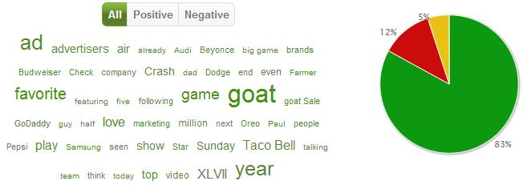


Out-come of Sentiment Analysis

Slide 7
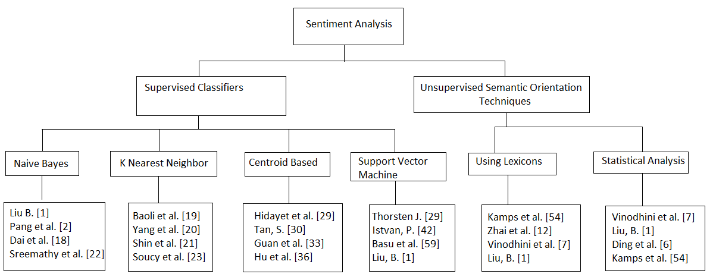
Sentiment Analysis Techniques

Slide 8
Open NLP Challenges
Document Level
Discussions
Sentence Level
Conditional sentences
Determining subjective sentences
Feature level
Grouping feature synonyms
Aspect-based mining
Domain dependent opinions
Opinion spamming
Comparative sentences
sharing opinion word
Identifying Opinion source and target
Negation
Stemming features
Pruning large feature set
Lexicon level
Opinion word orientation
Sarcastic terms
Object-attribute co-reference
Linguistic rules
Dual meaning words
Way of expression
Lack of opinion lexicons available
Informal nature of content

Slide 9
Applications
Opinion reason mining
News sentiments for trade strategies
Bias analysis
Popularity ranking
Tracking danger
Sentiments on government policies and its impact on stock exchange

Slide 10
Opinion Search
Key people views
List of well-known people in favor and against
Big data with many domains

Slide 11
Conclusion
Diversity of domains
Close ties with NLP
Huge unexplored data
Untidy content & amateur authors
Over reliance on Machine learning techniques
Supervised vs. Unsupervised

